Slide 1
Healthy Minds
and Bodies
Move, Move, Move
Professional Development: December 7, 2016
Presented by: Tim Smith, Allyson Sabia, & Natalie Rieke

Slide 2
I can:
Discuss the importance of Healthy Minds and Bodies: Move, Move, Move which addresses the needs of the whole child – academic, physical, and social-emotional
Explore and experience Move, Move, Move activities from the Generic Matrices
Share structures to ensure that this block is productive and beneficial to students and to the learning process
Notes:
Review outcomes. You might use information from the article that was sent out earlier http://www.ascd.org/ascd-express/vol12/1203-jensen.aspx

Slide 3
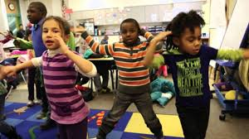
What are teachers saying?
“It gets our kids moving and keeps them focused when they need to be. It is a great incentive to working hard.”
“They need to move a lot in K so it’s very developmentally appropriate.”
“Students are energized.”
“Gives students a chance to get up and move between subjects.”

Slide 4
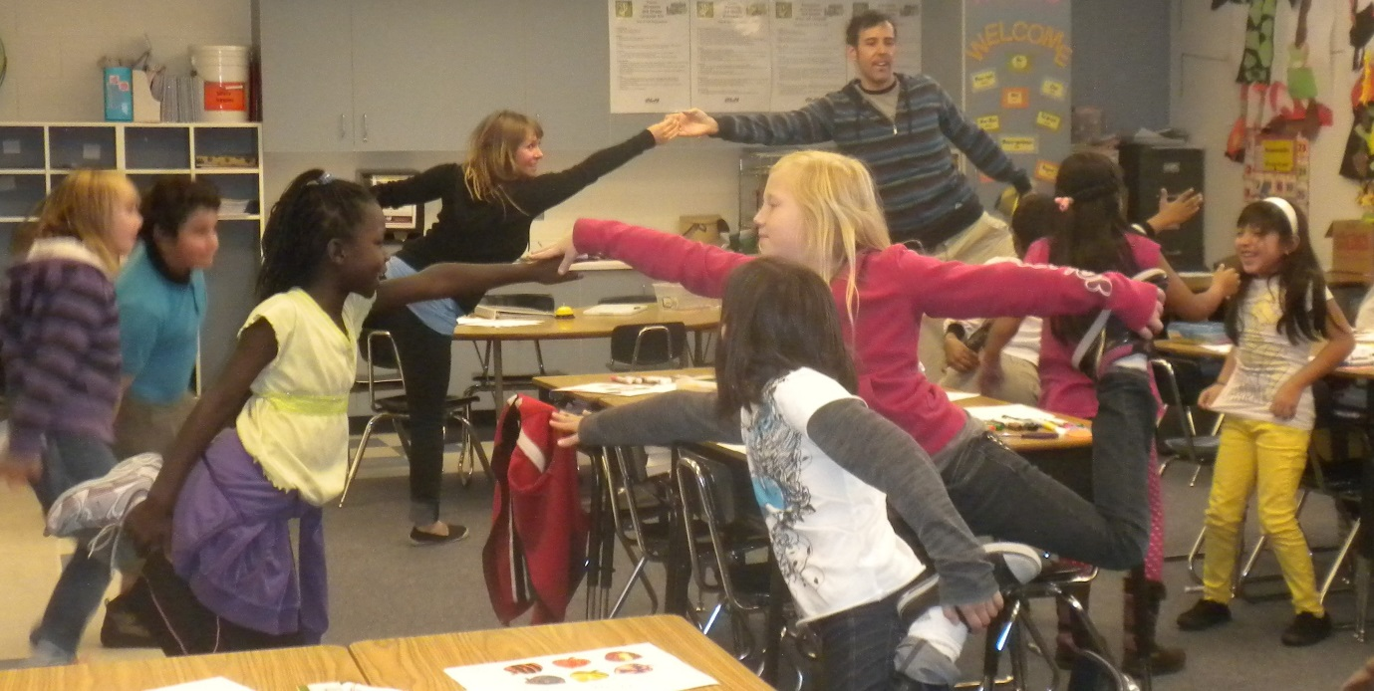
What are students saying?
“I like to dance because I can twirl.”
“I like to jump around because it makes me feel good in my body.”
“Movement makes me happy because I can jump around.”
“I feel excited when I am allowed to jump around and it makes me strong, too.”

Slide 5
It’s more than just movement!
Click Here to Find out Why!

Slide 6
Why is Move, Move, Move important?
Engages the brain
Increases academic performance
Physical
Student Centered
Language Development
Social
Student Reflection
Developing Coping Skills
Emotional
Notes:
These best practices or learning strategies not only meet the academic needs of our students but also have the power to impact student affect (behavior, engagement, choice), as well as being developmentally appropriate.
There is existing research on the positive effectives of physical activity on focus, cognition, and readiness to learn. In fact, the importance of making the connection between mind and body cannot be overemphasized.
What is good for your heart is good for your brain
Exercise prepares the brain for learning
provides natural opportunities to learn and practice self regulation and interpersonal skills;
engages diverse types of learners; and
fosters creativity and communication.
Movement enhances the learning process:
Enhances brain function
Increases circulation
Refocuses attention
Reduces stress
Reduces sitting time

Slide 7
Notes:
Red=Very active; Blue=Least active
If you had these two students in your classroom, which one would you prefer to teach? Facilitate a brief discussion.

Slide 8
Active kids learn better!
Notes:
Ask, “What surprises you about this information?”

Slide 9
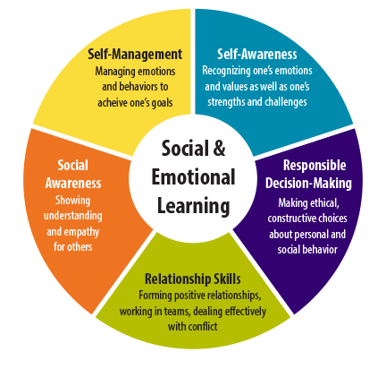
What is Social Emotional Learning(SEL)?
Process through which children and adults…
…acquire/apply knowledge, attitudes, & skills to understand and manage emotions
…set/achieve positive goals
…feel/show empathy
…establish/maintain relationships
…make responsible decisions
Notes:
Social Emotional Learning can occur naturally in the movement activities that are included in this block.
Say, “Think about a movement activity you have done with your kids. Which social emotional skills have they practiced? How did the activity support these skills?”

Slide 10
Implementing
Move, Move, Move
Notes:
Review outcomes. You might use information from the article that was sent out earlier http://www.ascd.org/ascd-express/vol12/1203-jensen.aspx

Slide 11
How could it flow?
Warm up or Mindful Breathing
Movement Activity
Refocus
Notes:
It is helpful to have a planned structure for delivering MMM activities. One suggestion is to start with an activity to prepare students, then deliver the activity itself, and close with an activity to help students refocus/transition back to an academic focus. One suggestion is:
Begin MMM with the Breathing Exercise, one of the Yoga videos, or a quick warm up – (Head, Shoulders, Knees and Toes, for example)
Choose an activity from the Generic Menu, which we will be exploring today, or there are activities connected to the Exploration Questions in the theme-specific menus.
Refocus with a Breathing Exercise or reflection discussion about what students experienced during the activity. What is something they learned/noticed, how do they feel after participating, what did they enjoy or want to do more of, what do they wish they had done?

Slide 12
Before we Play…
Form 5 small groups of at least 3 people. Try to have one grade level represented in each group. Each group will be assigned a particular section of the generic menu to try out.
Freeze Dance
Directed Movement
Mindfulness/Meditation
Just for Fun
Flexible Seating
Each group will choose and lead one activity from their section.
After each activity, the whole group will respond to the questions on the next slide.

Slide 13
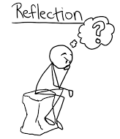
Let’s Play!
How would your students respond to these activities? Would they be engaged?
How do these activities support social emotional learning?
Ideas to enhance the activity?
Notes:
Facilitate discussion of the questions after each activity with the group.

Slide 14
Freeze Dance
Play music and allow participants to create movements while the music is on.
When the music stops, participants must freeze! Please choose someone in your group to be the “freezer” on the computer.
Dance & Movement
Shake it Off - Frozen
I can use dance and movement to express feelings.
Notes:
Hover the cursor over the video to play.

Slide 15
Directed Movement
I can follow directions.
I can work well with others.
I can make decisions.
LET’S MOVE!!
Old School Games

Slide 16
Mindfulness/Meditation
I can relax and focus.
Guided Imagery
Notes:
First have participants prepare for this Guided Imagery. Read slowly with pauses to allow time for all participants to fully experience this activity.
Say:
Sit up straight.
Place your hands in in your lap.
Close your eyes and try not to move at all.
Just breathe normally and feel your breath as it goes in and out of your nose
Take in a nice deep breath.
Allow your tummy to fill up like a balloon and then breath out slowly. Do this five times to really relax your whole body.
Now as your body relaxes, imagine you are a beautiful butterfly fluttering high in the sky. You see the lovely green valley below you with lots of colorful flowers, just waiting for you to enjoy.
You feel the wind blow against your delicate wings. As the wind touches you , it gently blows away any worries, any stress you feel.
Feel how wonderful it feels to be so free. Your mind is clear and calm. You have left any worries far behind now.
You are completely peaceful. You are beautiful as you allow your true happiness to shine through.
The sun touches your body and warms you. The big puffy clouds floating in t he sky remind you of how relaxed and calm you can be whenever you want, just by thinking about it. The earth is a patchwork of color and you enjoy each moment here, gliding along feeling so joyful and peaceful. You spread your wings far and stretch. It feels so good. Your body is calm and your mind is peaceful.
Pause here for a moment:
Take in a deep breath now and exhale slowly. When you are ready, give your body a big stretch. With a clear, calm mid, say to yourself: I am peaceful and I am calm, ready for learning. Open your eyes when you are ready.
Retrieved from http://www.greenchildmagazine.com/wp-content/uploads/2013/04/Guided-Relaxation.jpg

Slide 17
Just for Fun
Go Noodle - Milkshake
I can follow directions.
Go Noodle - Pop See Ko 2.0

Slide 18
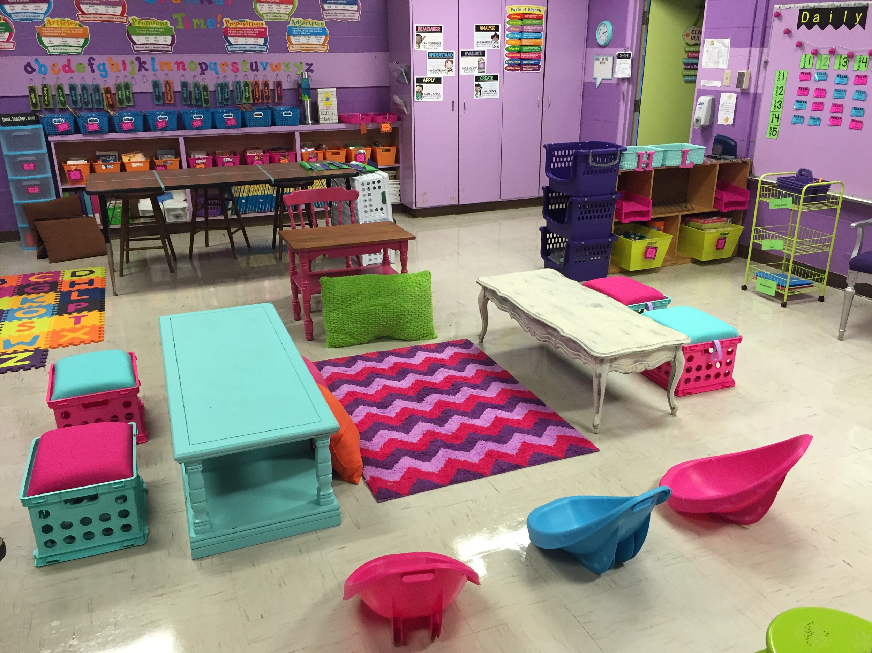
Flexible Seating
I can follow directions.
I can make decisions.

Slide 19
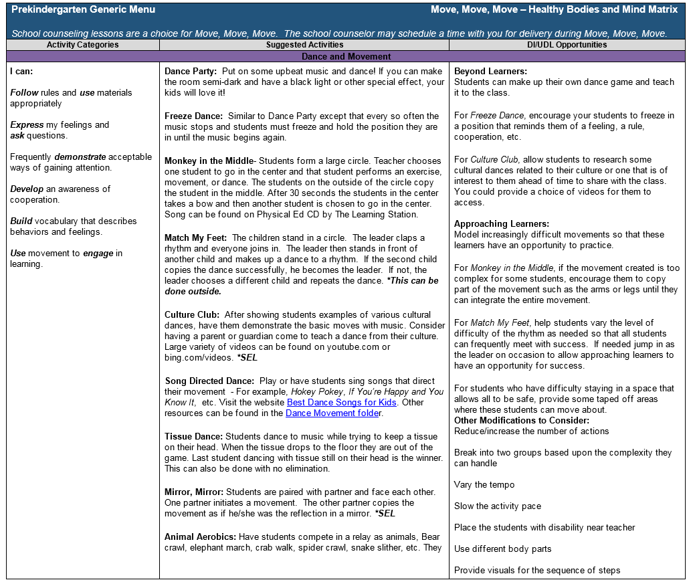
Generic Menu
Added to the Google Drive Folder FMES 2016-2017
for your convenience!
Notes:
There are two types of menus provided in MMM. The first is the generic menu, which you can choose from at any time. This is the menu we have been using today. The activities are not specifically linked to a daily exploration question, but are more general. The other is the theme-specific menu, which also includes the health standards lessons.

Slide 20
One Last Thing…
CSEFEL structures can support successful implementation of Move, Move, Move.
Move, Move, Move is different from a Brain Break - extended time for movement provides an opportunity for deeper engagement in social emotional learning, including conversation and social skills such as sharing, turn taking and problem-solving.
Questions?

Slide 21
Identify an activity you will try with your students in the next month
Notes:
Participants share the activity they will try.

